Slide 2
6:00-6:30
6:30-6:40 break
6:40-7:10
7:10-7:20 break
7:20-7:50
7:50-8:00 break
8:00-8:30
8:30-8:40 break
8:40-9:00

Slide 3

Dec 2016: I discover this computer language called “J,” and I’m motivated by its difficulty and obscurity
Dec-Apr: I study J and develop a way to teach it
Apr 19: J workshop at Stetson for comp. sci. students
Notes:
bitcoin =: ". > 1 {"1 readcsv'/Users/JoshuaEckroth/Documents/git/zigzag/tomoka/bitstampUSDsmall.csv'
(seated) challenge: if I bought $100 of bitcoin at the beginning, how much are they worth now?
btc =: 100 % {. bitcoin
btcNow =: btc * {. |. bitcoin

Slide 4
LEARN To
RECOGNIZE
A GOOD
KNOWLEDGE
TRANCE
Notes:
explain who frank is

Slide 5
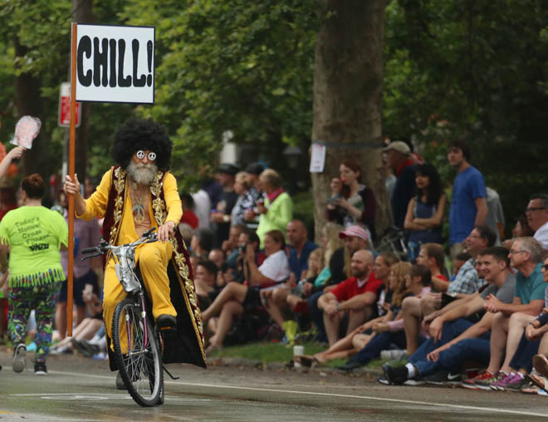
Notes:
Zigzagging through the Straight and Narrow (2009)

Slide 6
BREAK FROM THE BLUB
FIGHT IRONY
PERSEVERE
Notes:
Break from the blub: recognize the value of different approaches; avoid the generalist’s trap
Fight irony: e.g. brainfuck sucks
Persevere: google is useless, docs are very terse; stackoverflow: 1.4 mil javascript tags, 32k haskell, 8k prolog, 243 j

Slide 7
J
a computer language for mathematical computations

Slide 8
J
obscure, terse, powerful,
brilliantly designed...

Slide 9
J
Example: drop lowest x grades from list y, then average the grades
((+/%#)@:((}.@:/:~)^:x)) y
ignore first
add grades
sort
repeat
count grades
drop lowest
the grades
divide
do left thing
after right thing is done
how many to drop

Slide 10
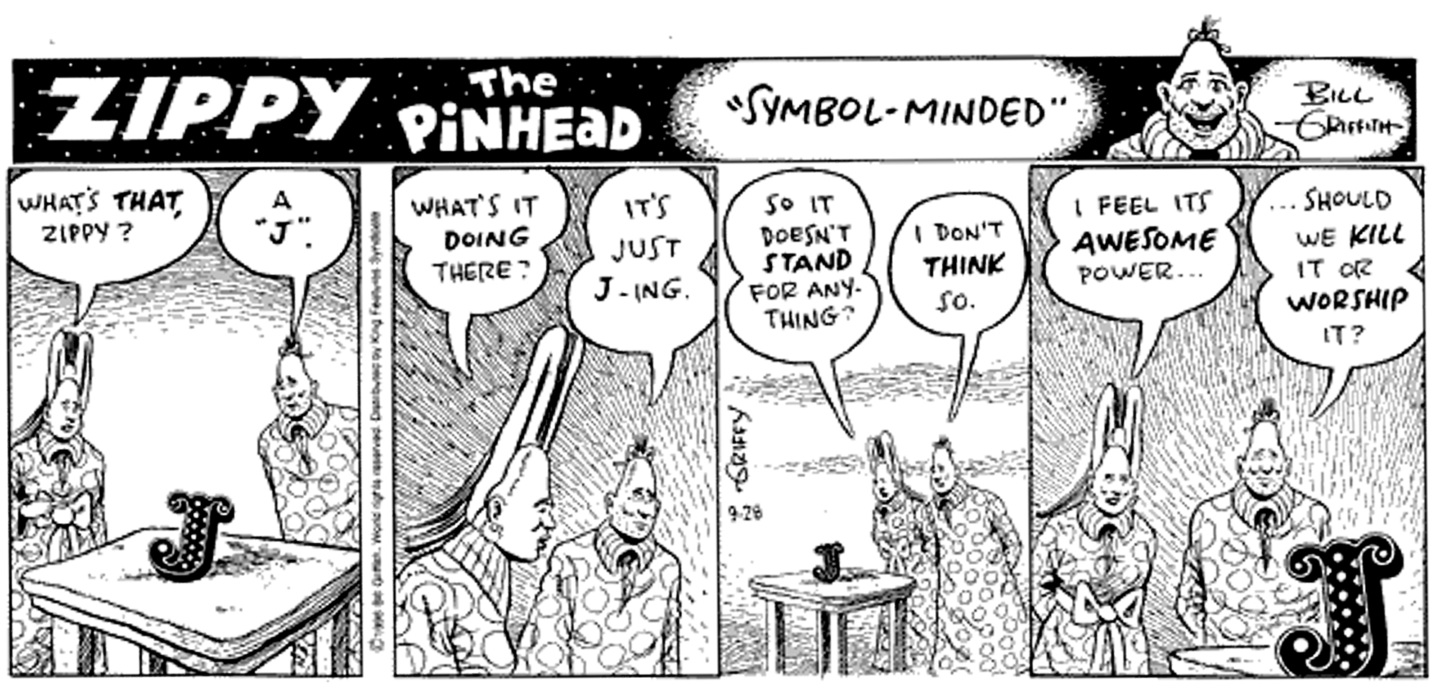

Slide 12
Leaping head first into the stream of consciousness is good for your balance

Slide 13
Syntax

Slide 14
Statements are exactly one line long
Numbers may be written 2, _2, 0.5
Adjacent numbers make an array (list): 3 _5 2.333 7
Everything else is a “word”:
Verbs: +, -, %, etc.
Adverbs: ~, /, }, etc.
Others: =., =:, NB., etc.

Slide 15
Evaluation Rules

Slide 16
Forget the table of operator precedence!
J for C Programmers

Slide 17
Right-to-left evaluation:
2*4+5
18
2+4*5
22
(2*4)+5
13
Notes:
No precedence rules except parentheses ()

Slide 18

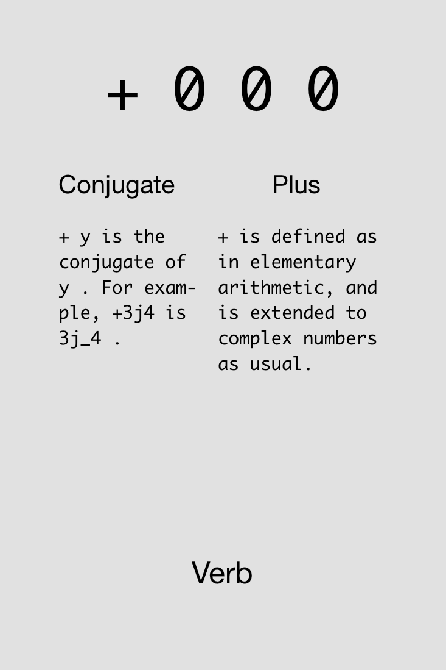
Notes:
Show example in J: 4+5+2

Slide 19

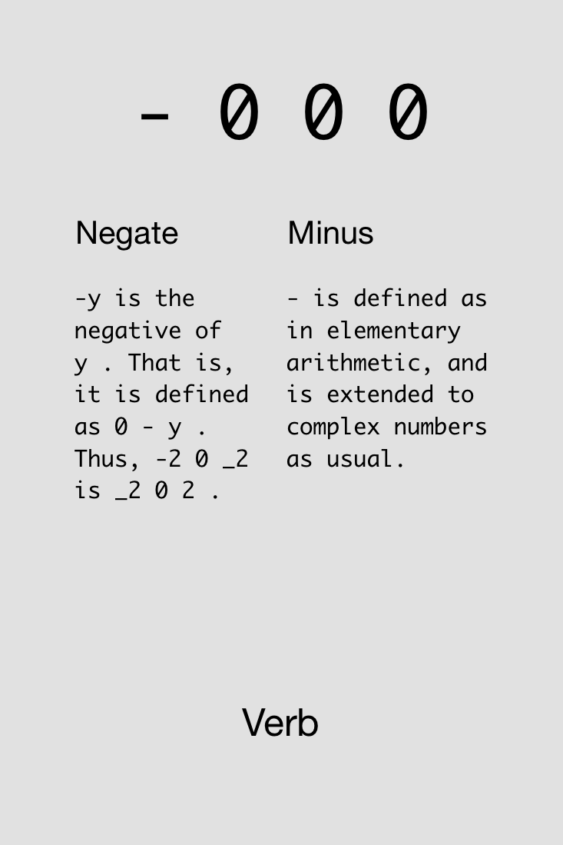

Slide 20
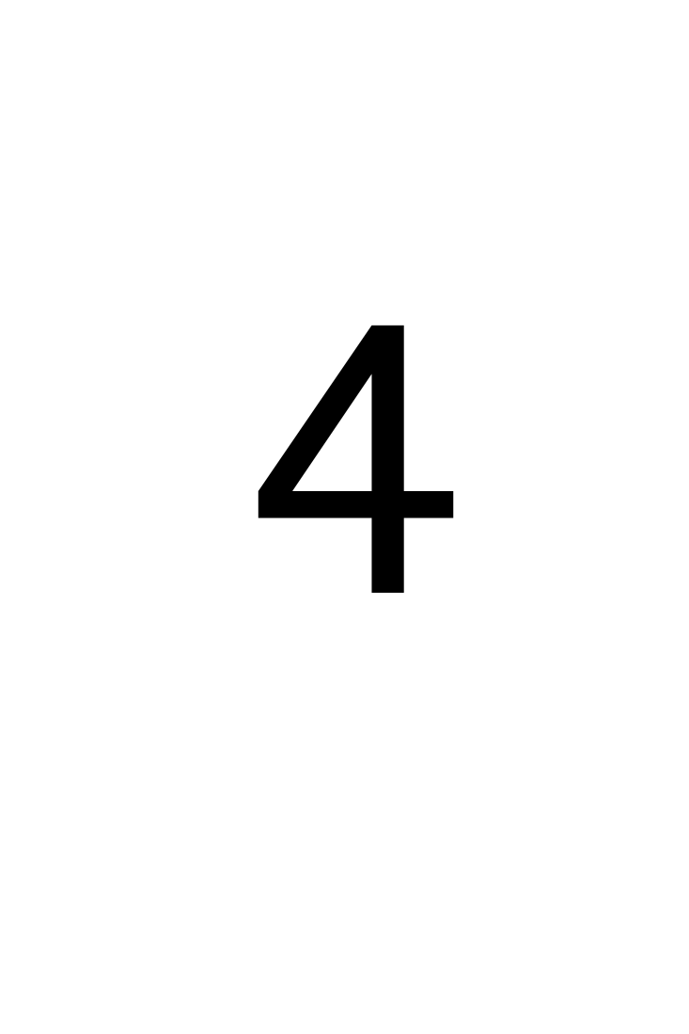
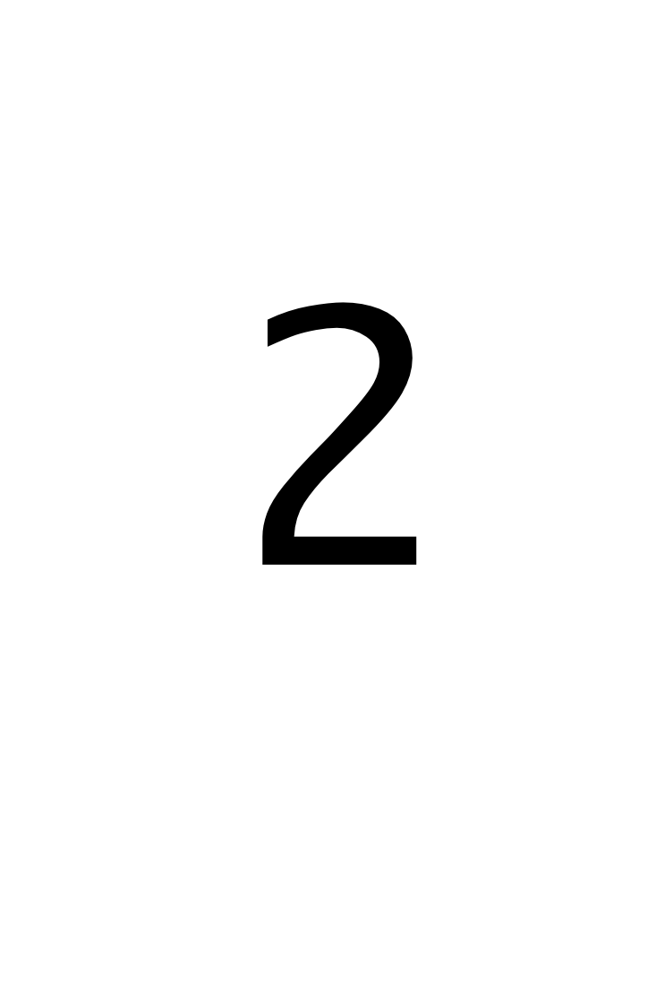



Challenge!
Compute 4-3+2 (which = 3). Try reorderings: 4+2-3, etc.
Find four solutions using all of these cards simultaneously:
4x
4x
4x
4x
4x
2x
2x

Slide 21
Solutions!
Compute 4-3+2 (which = 3).

Slide 22
Solutions!
Compute 4-3+2 (which = 3).

Slide 23

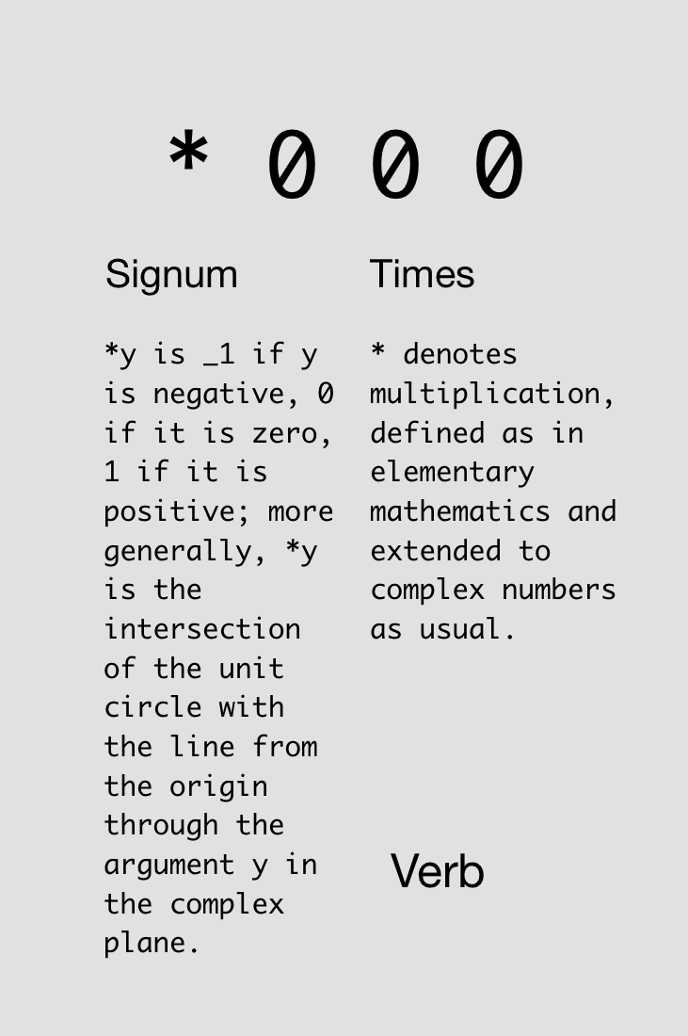

Slide 24

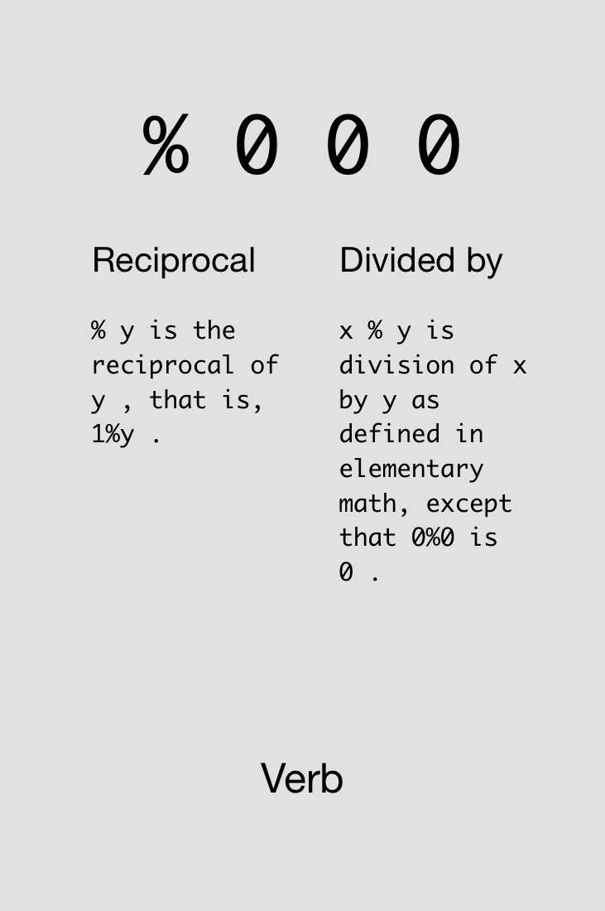

Slide 25
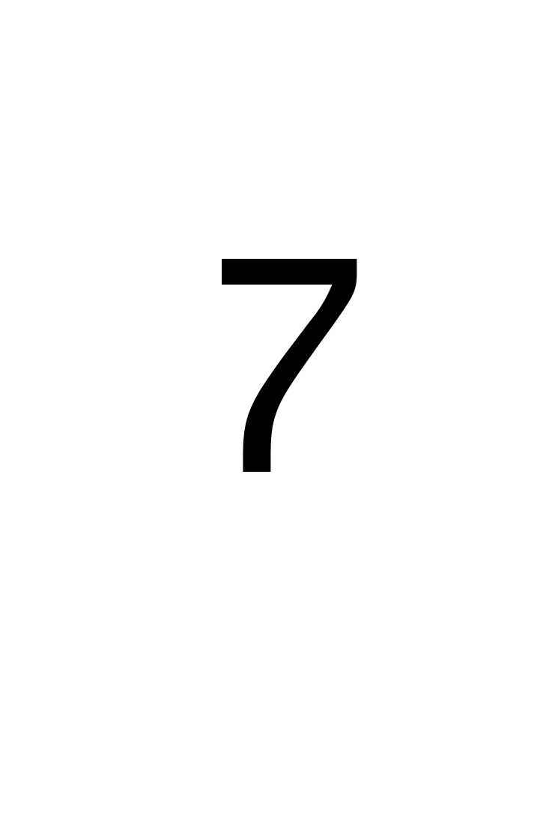
Challenge!
Compute the average of 4 and 7.
Find two solutions using all of these cards simultaneously:
2x
2x
3x
2x
3x
2x
2x

Slide 26
Solutions!
Compute the average of 4 and 7.

Slide 27
Monads & Dyads

Slide 28
y is right arg
x is left arg,
y is right arg

Slide 29
Monadic vs. Dyadic %:
2%7
0.285714
7%2
3.5
%7
0.142857
%2
0.5

Slide 30
Challenge!
Compute the average of -4 and -7.
Find three solutions using all of these cards simultaneously:
3x
3x
4x
3x
3x
4x
2x
2x

Slide 31
Solutions!
Compute the average of -4 and -7.

Slide 33
Try not to reinvent the rut

Slide 34

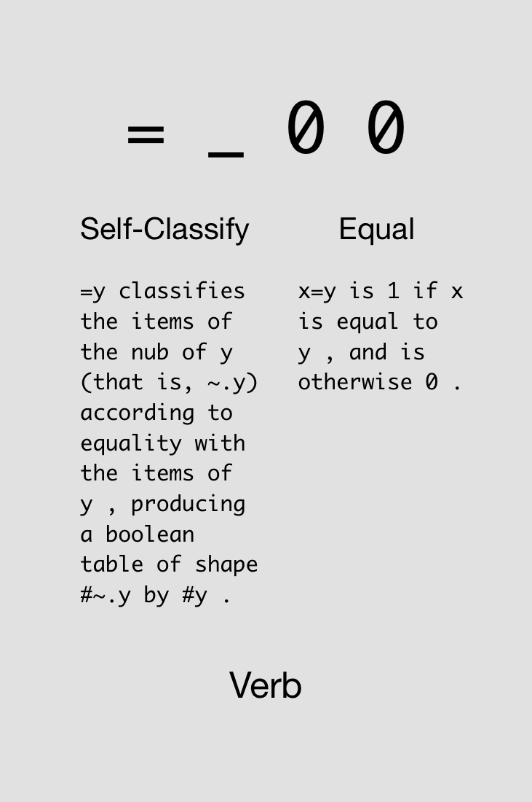

Slide 35

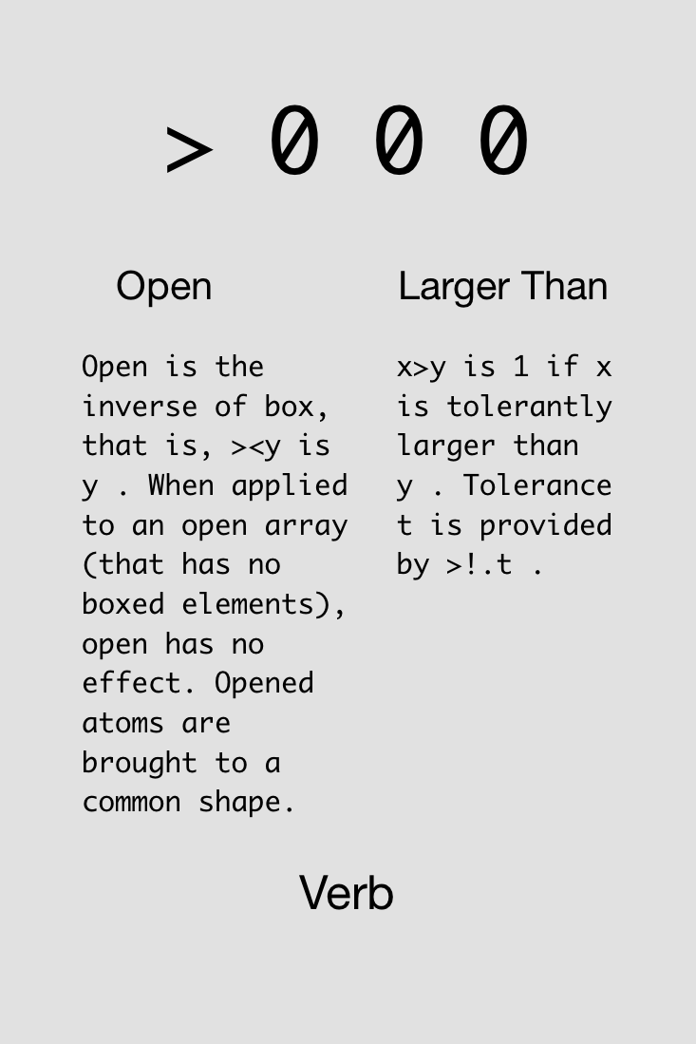

Slide 36
Examples of binary functions.
5 > 4
1
5 < 4
0
0 = 5 > 4
0
5 > 4 = 0
1 (oops, this is really 5>0!)

Slide 38
Multiplication (‘*’) can be used as “AND”.
5 > 4
1
4 > 3
1
(5>4) * (4>3)
1
(5>4) * (3>4)
0

Slide 39

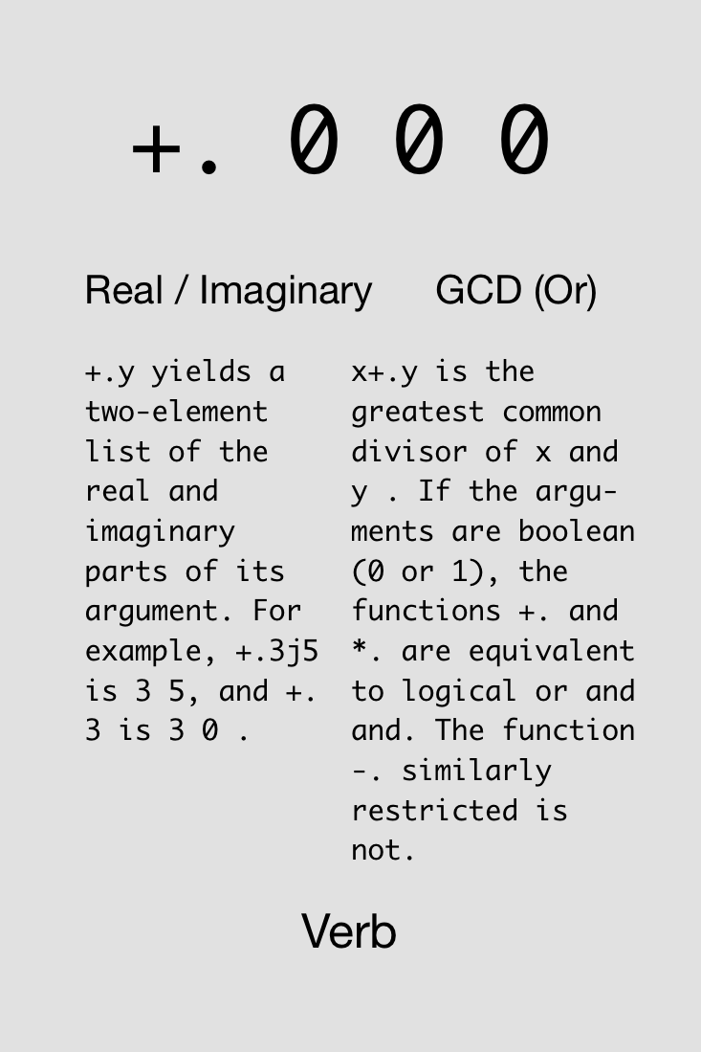

Slide 40



Challenge!
Compute 4 ≤ 5 (which = 1).
Find two solutions using all of these cards simultaneously:
3x
3x
1x
1x
1x
1x
1x
1x

Slide 41
Solutions!
Compute 4 ≤ 5 (which = 1).

Slide 42

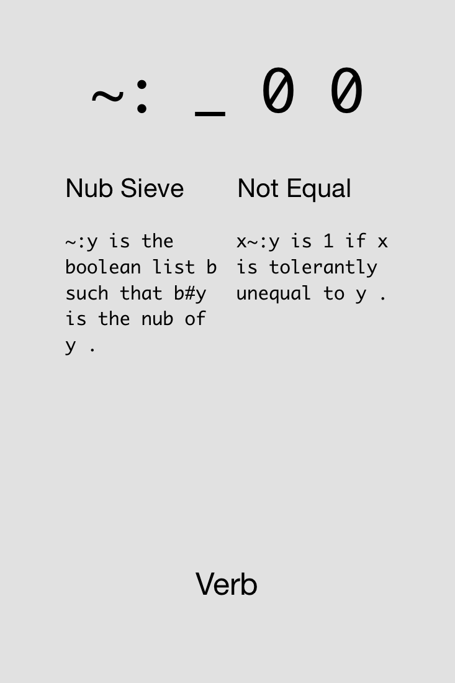

Slide 43

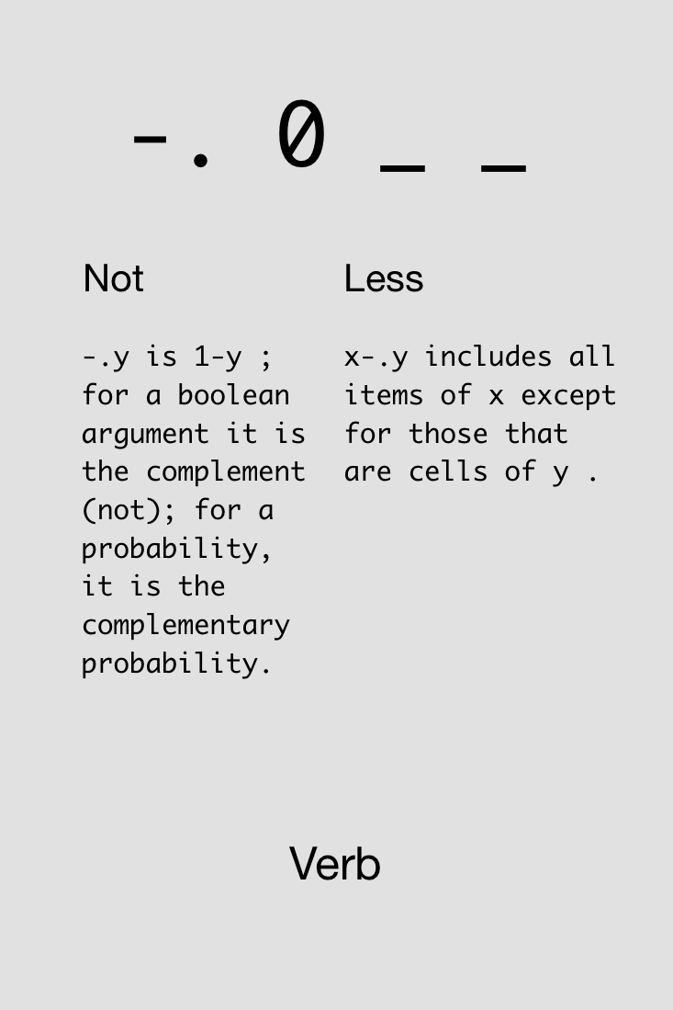

Slide 44

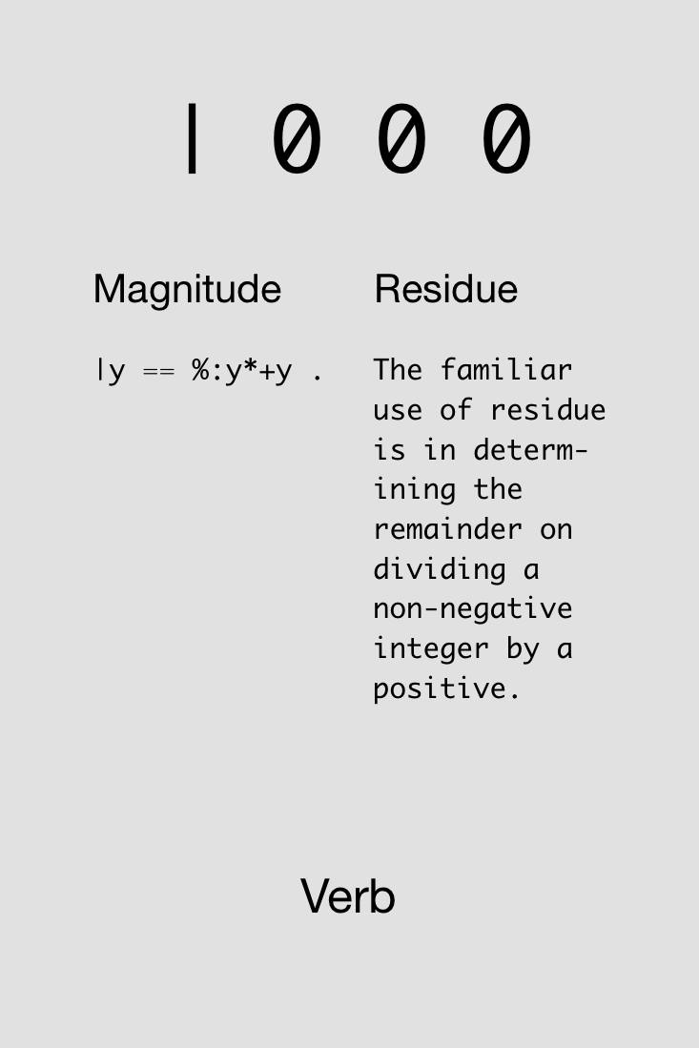

Slide 45
“Residue” gives the remainder after dividing.
2 | 5 NB. e.g., 5/2 = 2 + 1/2
1
2 | 6 NB. e.g., 6/2 = 3 + 0/2
0
3 | 8 NB. e.g., 8/3 = 2 + 2/3
2
4 | 102 NB. e.g., 102/4 = 25 + 2/4
2

Slide 46


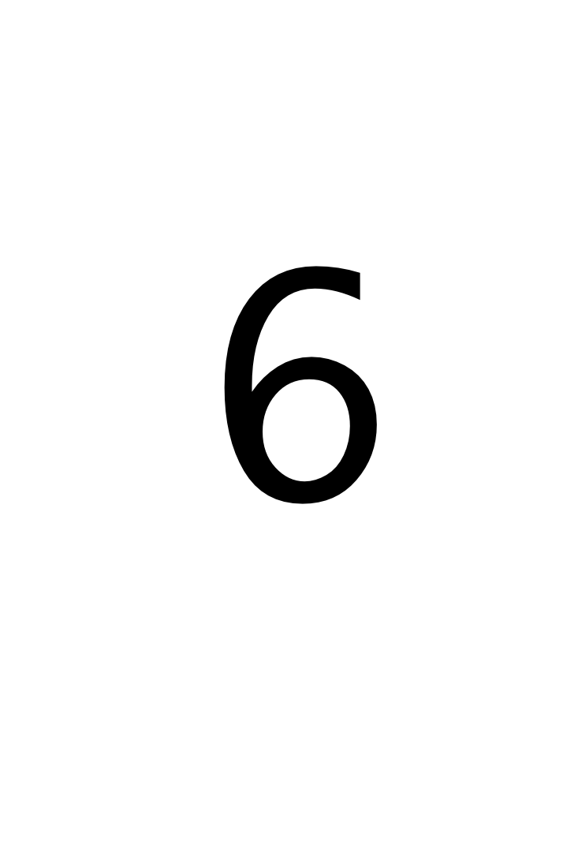
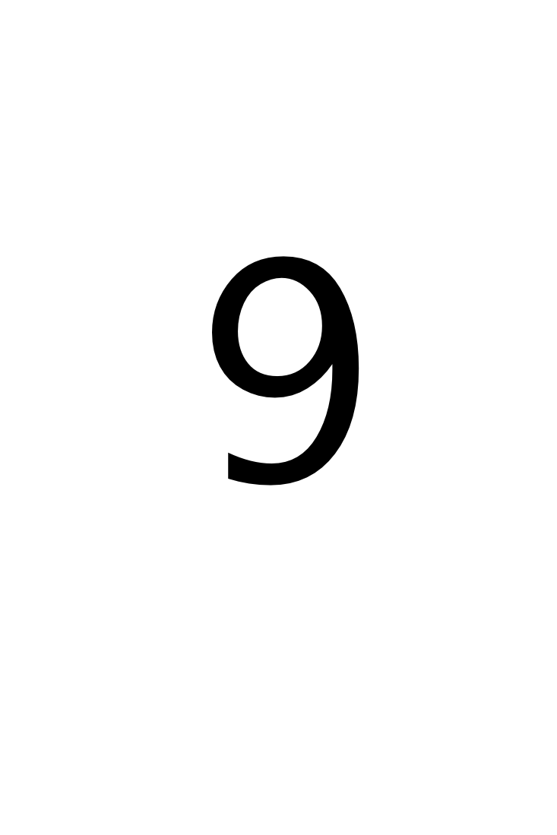
Challenge!
Determine if 1996 was a leap year. A leap year is divisible by 4 (i.e., reside is 0), but not divisible by 100.
Find one solution using all of these cards simultaneously:
1x
1x
3x
2x
4x
2x
1x
1x
1x
2x
2x

Slide 47
Solution!
Determine if 1996 was a leap year. A leap year is divisible by 4 (i.e., reside is 0), but not divisible by 100.

Slide 49
Avoid both picking at minutia and sideswiping mountains

Slide 50
Arrays

Slide 51
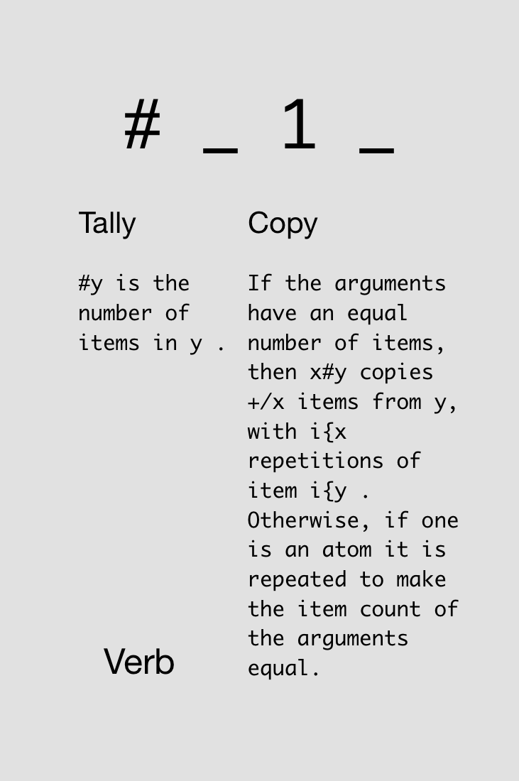

Notes:
Just monadic form

Slide 52
Typing arrays and asking their size:
5 3 7 9
5 3 7 9
# 5 3 7 9
4
# 7
1
# # 1 2 3
1

Slide 53
Notes:
Now dyadic form

Slide 54
Using dyadic “#” for copying:
3 # 10
10 10 10
2 # 5
5 5
0 # 7
_2 # 7
|domain error

Slide 55
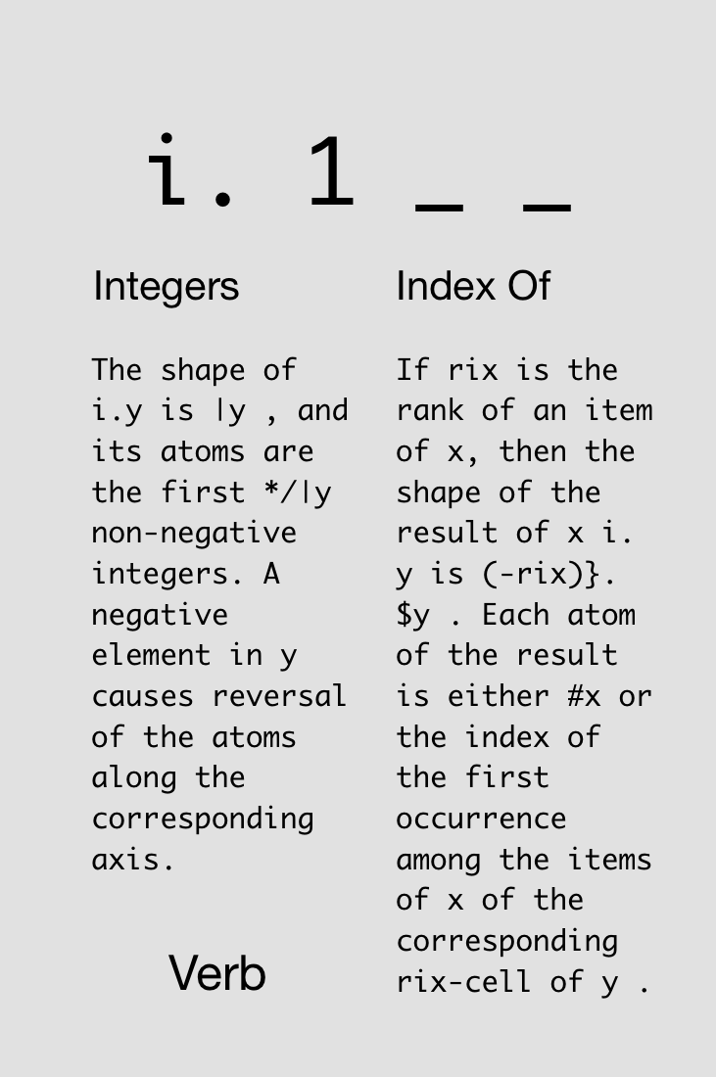


Slide 56
i.4
0 1 2 3
3+i.4
3 4 5 6
3#i.4
0 0 0 1 1 1 2 2 2 3 3 3
#3#i.4
12
3##i.4
4 4 4

Slide 57
In J, every operator has a loop built in.
J for C Programmers

Slide 58
Automatic element-by-element operations:
1 2 3 + 4 5 6
5 7 9
1 + 4 5 6
5 6 7
1 2 + 4 5 6
|length error
| 1 2 +4 5 6

Slide 59
Automatic element-by-element operations:
3 # 4 5 6
4 4 4 5 5 5 6 6 6
1 2 3 # 4 5 6
4 5 5 6 6 6
1 2 3 # 4
4 4 4 4 4 4
1 2 # 4 5 6
|length error
| 1 2 #4 5 6

Slide 60
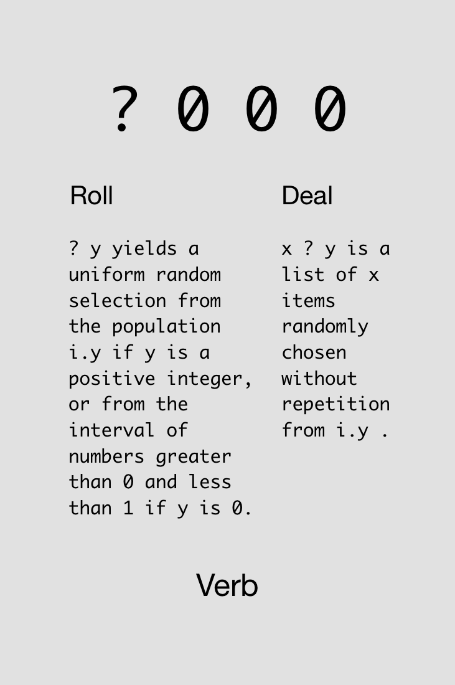



Slide 61
Rolling a die:
? 6
5
? 6
3
? 6 (oops, 0 is not valid)
0
1 + ? 6 NB. 1+ to get nums 1-6
6

Slide 62
Rolling multiple dice:
? 6 6 6
3 0 2
1 + ? 6 6 6 6 6
2 2 3 1 2

Slide 63

Challenge!
Roll 5 dice.
Find two solutions using all of these cards simultaneously:
1x
2x
2x
2x
2x
1x
1x

Slide 64
Solutions!
Roll 5 dice.

Slide 65
Adverbs
Notes:
Loopless coding

Slide 66
A noun holds data; a verb operates on one or two nouns to produce a result which is a noun; an adverb operates on one noun or verb to produce a derived entity.
J for C Programmers

Slide 67
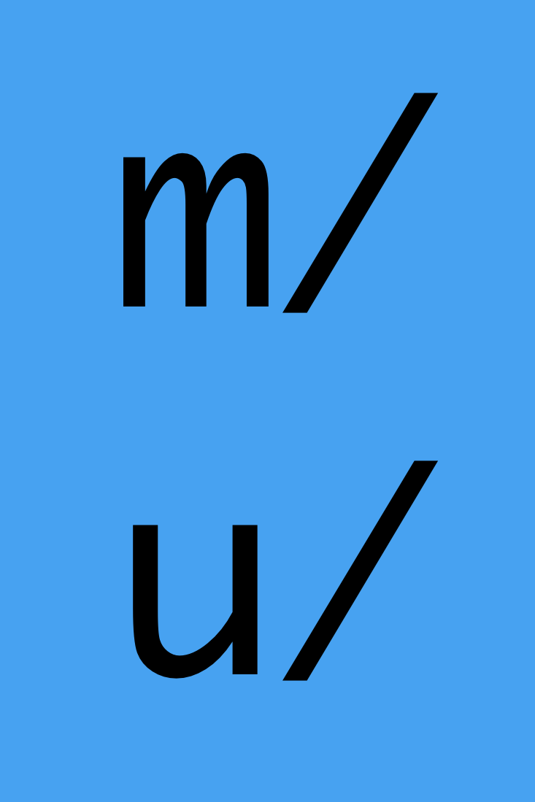
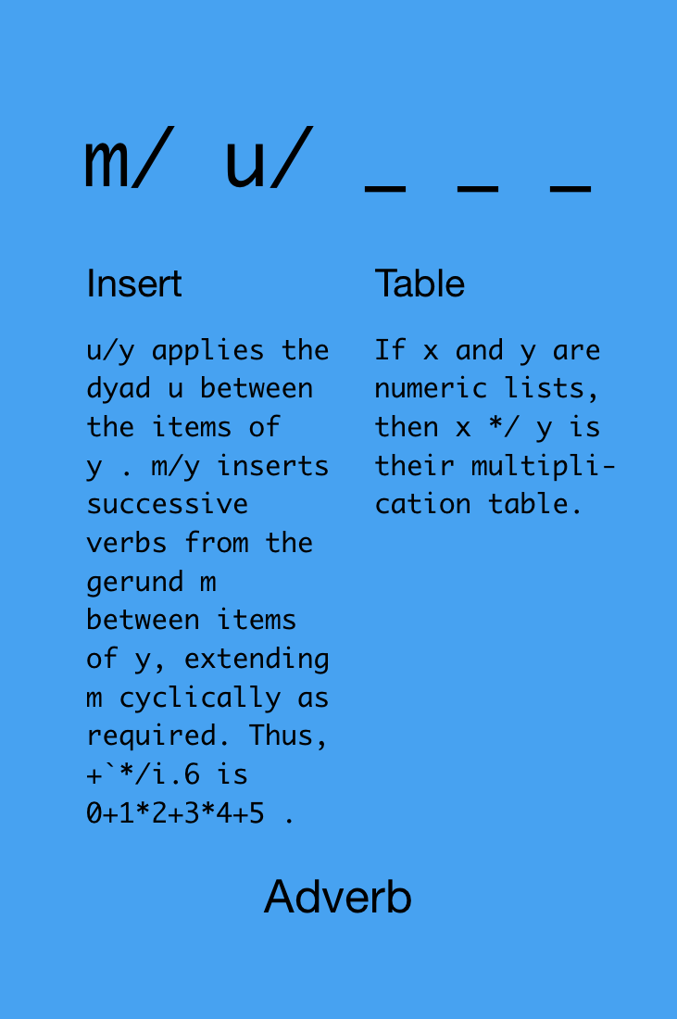

Slide 68
1+2+3+4+5
15
+/1 2 3 4 5
15
*/1 2 3 4 5
120
+/i.10 NB. i.e., 0+1+2+...+9
45

Slide 69
+/?5#6 NB. add 5 dice rolls
16
+/?5#6 NB. do it again, new rolls
9
NB. find average of array 3 5 11
(+/ 3 5 11) % (# 3 5 11)
6.33333

Slide 70
Challenge!
Determine if any of 5 dice rolls was a 6 (=1 if yes, =0 if no).
Find two solutions using all of these cards simultaneously:
2x
4x
2x
2x
2x
2x
1x
1x
1x
2x

Slide 71
Solutions!
Determine if any of 5 dice rolls was a 6 (=1 if yes, =0 if no).

Slide 73
Never put a seat belt around your intuition

Slide 74
Definitions

Slide 75
We can save data into a “variable”:
temps =: 86 85 83 87
Now we can use the variable in computations:
# temps
4
+/ temps
341

Slide 76
We can also define new verbs.
avg =: monad define
(+/ y) % (# y)
)
Now we can use the verb in computations:
avg temps
85.25

Slide 77
When defining monads, we can refer to “y”. When defining dyads, we can refer to “x” and “y.”
rollDice =: dyad define
>:?x#y
)
Now we can use the verb in computations:
5 rollDice 6
2 2 6 5 3
3 rollDice 20
8 12 11

Slide 78
We can load data files and save the data into a variable for further computations.
(Demo)
Notes:
load 'csv’
delandTemps =: ". > 4 {"1 readcsv'/Users/JoshuaEckroth/Documents/git/zigzag/tomoka/deland-temps.csv’
delandTemps
# delandTemps
avg delandTemps

Slide 79
More Verbs

Slide 80

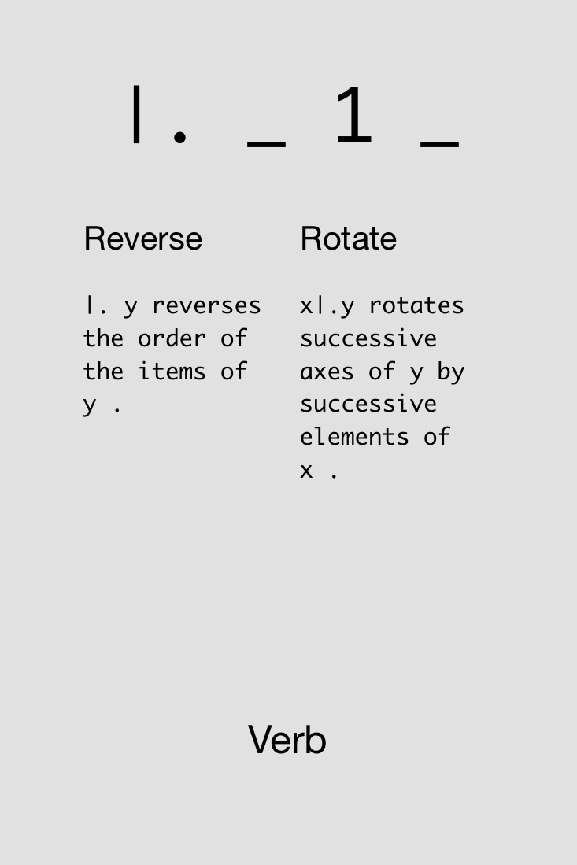

Slide 81

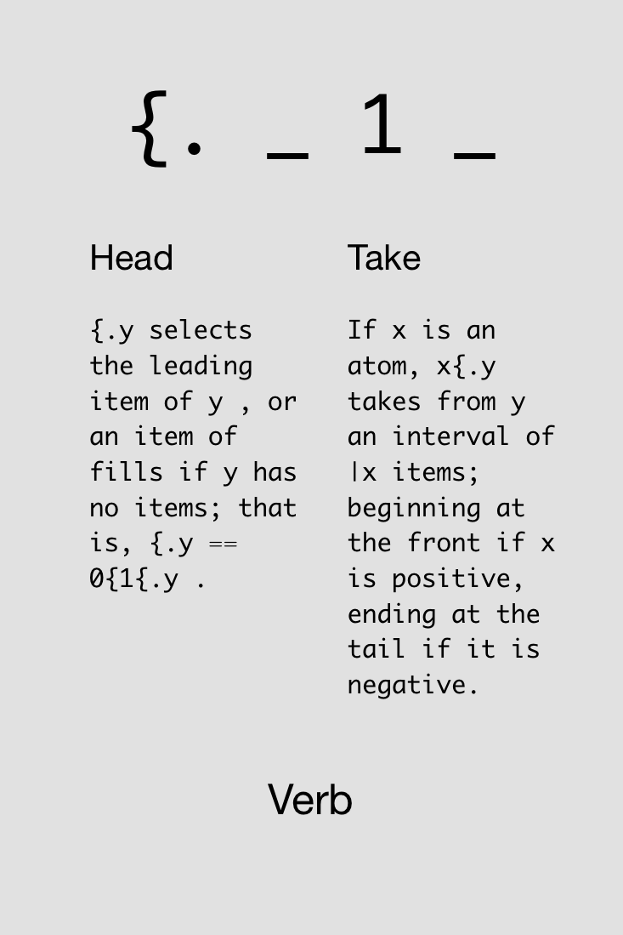

Slide 82
(Demo)
Notes:
load 'csv’
delandTemps =: ". > 4 {"1 readcsv'/Users/JoshuaEckroth/Documents/git/zigzag/tomoka/deland-temps.csv’
delandTemps
# delandTemps
avg delandTemps

Slide 83
More Adverbs

Slide 84
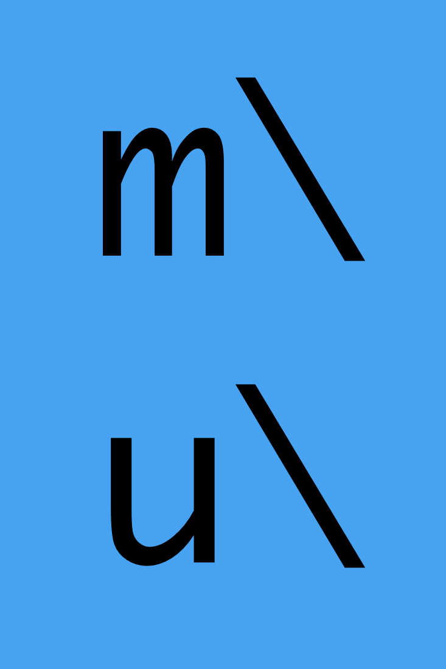
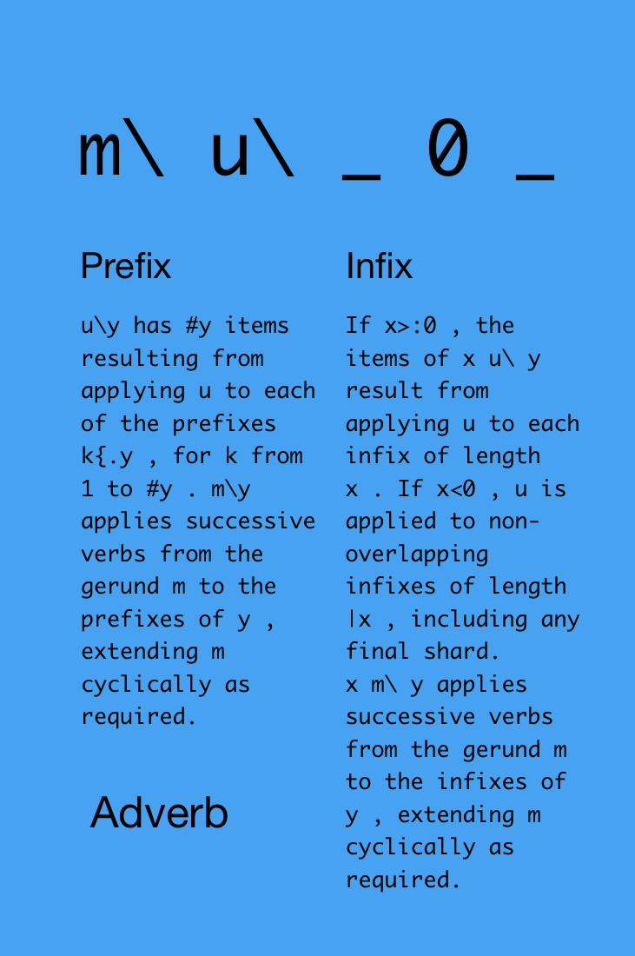

Slide 85
Monadic form:
#\ 3 2 7 1
1 2 3 4
NB. that was the same as:
(# 3), (# 3 2), (# 3 2 7), (# 3 2 7 1)
1 2 3 4

Slide 86
Monadic form:
+/\ 3 2 7 1
3 5 12 13
NB. that was the same as:
(+/ 3), (+/ 3 2), (+/ 3 2 7), (+/ 3 2 7 1)
3 5 12 13

Slide 87
Dyadic form:
2 #\ 3 2 7 1
2 2 2
NB. that was the same as:
(# 3 2), (# 2 7), (# 7 1)
2 2 2

Slide 88
Dyadic form:
2 +/\ 3 2 7 1
5 9 8
NB. that was the same as:
(+/ 3 2), (+/ 2 7), (+/ 7 1)
5 9 8

Slide 89
Dyadic form, negative left side means “non-overlapping”:
_2 +/\ 3 2 7 1
5 8
NB. that was the same as:
(+/ 3 2), (+/ 7 1)
5 8

Slide 90
(Demo)
Notes:
compute averages over (nearly) each week:
btcWeekly =: (-(6*24*7)) avg\ bitcoin

Slide 91

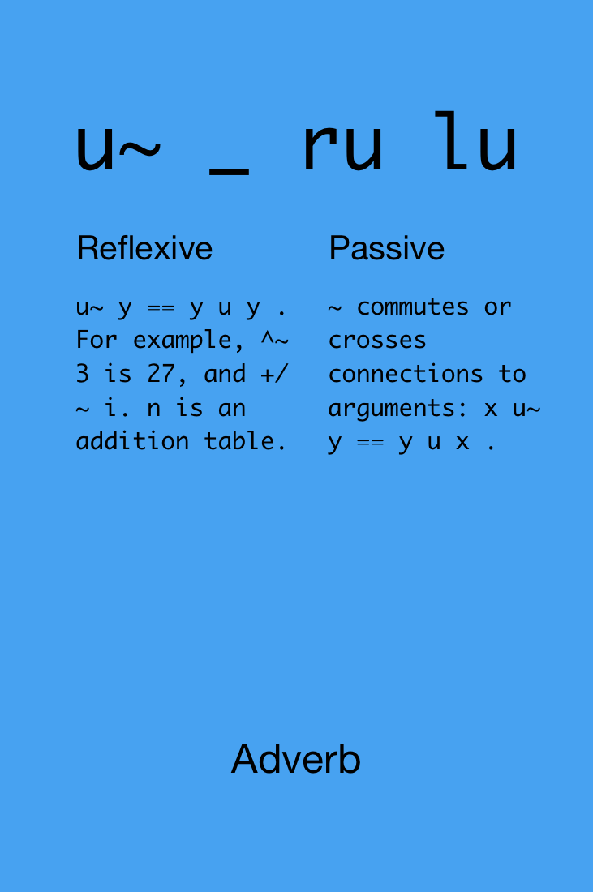

Slide 92
5 - 2
3
5 -~ 2
_3
2 -/\ 10 7 8 4
3 _1 4
2 -~/\ 10 7 8 4
_3 1 _4

Slide 93
(Demo)
Notes:
biggest week drop?
btcWeeklyChanges =: 2 -~/\ btcWeekly
<./ btcWeeklyChanges
and biggest week gain?
>./ btcWeeklyChanges

Slide 95
Sliding your brain into neutral
engages your spiritual transmission

Slide 96
Visualization

Slide 97
(Demo)

Slide 98


Slide 99
STAY
IN THE
PLEASANT
TENSE

